Slide 1
IBM University Engagement Project Submission
“Exploring the Power of Agentic AI with IBM Granite and LangFlow”

Slide 2

Project Tile – [Recipe Agent ]
Domain of Project – [Food Technology / Smart Cooking / Consumer AI ]
Student Name | Recent Passport Photo | Email ID | Mobile number [WhatsApp]
Azim Khan |  | aahil1458@gmail.com | 9657827076

Slide 3
Problem Statement -
Problem Statement : Recipe Preparation Agent
The Challenge
Cooking becomes difficult when users only have limited ingredients at home. People often struggle to decide what to cook, leading to repetitive meals and food waste. Reliable recipe guidance is scattered, and most systems do not adapt to available groceries or dietary needs. Without intelligent assistance, users cannot efficiently turn pantry items into complete meals.
The Objective
Build an AI-powered Recipe Preparation Agent that delivers personalized dietary insights and guidance for individuals, families, and health professionals. The solution should:
Build an AI-powered Recipe Preparation Agent using IBM Granite (RAG-based system)
Generate personalized recipes based on available ingredients and user preferences
Provide step-by-step cooking instructions with cooking time and ingredients list
Suggest smart ingredient substitutions when items are missing Adapt recipes based on cuisine type and dietary needs (Veg/Vegan/Non-Veg)
Reduce food waste and simplify everyday cooking

Slide 4
Technology Used
Tech Stack (Mandatory)
LangFlow for building and orchestrating the workflow (visual AI pipeline)
IBM watsonx.ai for accessing and deploying foundation models
IBM Granite Models for AI-powered recipe generation and response creation
RAG (Retrieval-Augmented Generation) for fetching and enhancing recipe knowledge
Python for backend logic and integration
Streamlit for building the user interface

Slide 5
Proposed Solution -
Proposed Solution: AI-Powered Recipe Preparation Agent
The proposed solution is a multi-agent AI-powered Recipe Preparation Agent built using LangFlow, IBM watsonx.ai, and Granite Models to help users cook meals using only the ingredients available at home. The system addresses challenges in meal planning, ingredient limitations, and food waste through an intelligent, modular architecture.
At its core, the solution uses a Retrieval-Augmented Generation (RAG) pipeline to fetch relevant recipes from a structured recipe dataset and trusted food knowledge sources. This retrieved context is then processed and enhanced using IBM Granite models to generate personalized, step-by-step cooking instructions based on user inputs.
The system consists of four key agents:
Recipe Knowledge Agent retrieves relevant recipes using RAG and structured food datasets.
Ingredient Analysis Agent identifies available ingredients and determines possible recipes based on them.
Recipe Adaptation Agent modifies recipes based on cuisine type, dietary preferences (Veg/Vegan/Non-Veg), and missing ingredients.
Cooking Instruction Agent generates clear, step-by-step cooking instructions with cooking time and tips.
The solution includes a simple and user-friendly interface (built with Streamlit) where users input available ingredients, cuisine type, and dietary preference. The system then generates complete recipes including ingredients list, substitutions, and cooking steps.
LangFlow is used to design and orchestrate the workflow, while watsonx.ai enables model integration and scalable deployment. Granite models power reasoning, recipe generation, and natural language responses. The RAG pipeline ensures accurate and context-aware recipe suggestions.
Overall, this solution delivers an end-to-end intelligent cooking assistant that transforms available groceries into practical meals, reduces food waste, and makes everyday cooking easier and more efficient.

Slide 6
Langflow component Used -
1) Chat Input
Interface where users provide recipe requirements such as:
Selected cuisine (Indian, Chinese, Italian, etc.)
Diet preference (Vegetarian / Vegan / Non-Vegetarian)
Number of servings
Maximum cooking time
Available ingredients (text input list)
2) IBM watsonx AI Agent
Processes user inputs using IBM Granite models to generate personalized recipes. It analyzes cuisine type, dietary preference, cooking time, and available ingredients to create optimized meal suggestions.
3) Name of IBM Granite Model
Granite-13B-Instruct (or Granite-3.x Instruct) → Used for generating structured recipes including ingredients, substitutions, and step-by-step cooking instructions in real time.
4) Chat Output
Displays AI-generated recipe results including:
Recipe name
Required ingredients (based on user input)
Step-by-step cooking instructions
Cooking time and servings
Smart substitutions for missing ingredients
5) File Component
Stores and manages:
User input history (ingredients, cuisine, preferences)
Sample recipe dataset for RAG retrieval
Cooking templates and structured recipe formats
6) Additional Component Used
RAG (Retrieval-Augmented Generation) System
Retrieves relevant recipes based on ingredients and cuisine
Enhances output using IBM Granite model
Ensures accurate, contextual, and personalized recipe generation
Streamlit UI Component
Provides interactive interface with:
Cuisine selector
Diet preference dropdown
Servings slider
Cooking time slider
Ingredient text box

Slide 7
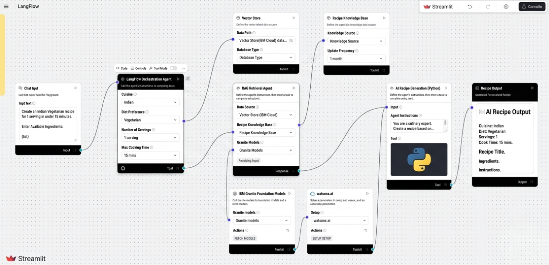
Langflow workflow -

Slide 8
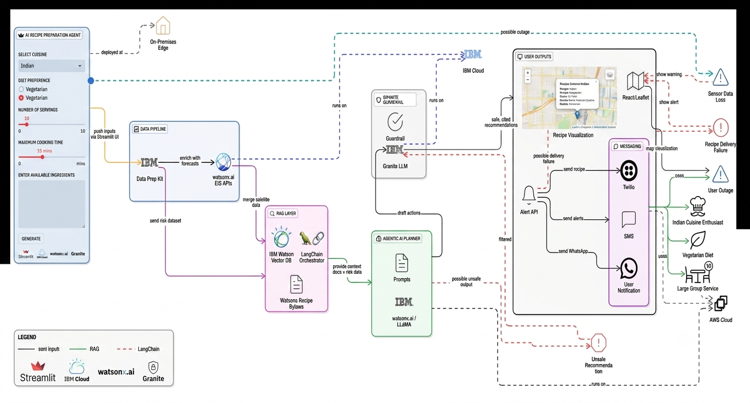
Architecture blueprint

Slide 9

Role of Agentic AI in the solution
Role of Agentic AI in Recipe Preparation Agent
Agentic AI enables the Recipe Preparation Agent to function as an intelligent, autonomous system rather than a simple chatbot. Using IBM watsonx.ai and IBM Granite models, it coordinates multiple specialized agents to deliver personalized culinary guidance. Each agent performs a specific role—such as retrieving recipe data, generating diet plans, providing cooking advice, and analyzing ingredient logs—while working collaboratively. This multi-agent approach ensures efficient task execution and accurate results. Agentic AI also brings context awareness, understanding user details like dietary restrictions, preferred cuisines, and time constraints to generate tailored recommendations. It supports real-time adaptation, continuously updating suggestions based on user inputs like available ingredients. Additionally, agents communicate with each other, enabling better decision-making and improved outcomes. Overall, Agentic AI makes the system proactive, personalized, and goal-driven, acting like a smart digital sous-chef that helps users maintain a healthy lifestyle.

Slide 10
Technology Used
Langflow platform - For designing and orchestrating multi-agent workflows visually
IBM Granite model - for eg – ibm-granite-3-2-8b – For natural language understanding, reasoning, and personalization
IBM Cloud – It provides the infrastructure to build, deploy, and scale the Recipe Preparation Agent efficiently. IBM Cloud enables a reliable, secure, and scalable environment for deploying the Recipe Preparation Agent.
RAG – RAG to fetch real data first, then generate intelligent answers, making the Recipe Preparation Agent more trustworthy and effective.
IBM Watsonx.ai - For model deployment, embeddings, and AI governance
Vector Database (FAISS/Chroma) – For RAG-based recipe data retrieval

Slide 11
Novelty and Uniqueness
The proposed Recipe Preparation Agent stands out by combining Agentic AI, RAG, and personalization into a single intelligent system.
Multi-Agent Intelligence – Instead of a single chatbot, multiple specialized agents collaborate to deliver accurate and context-aware recipe guidance.
RAG-Based Accuracy – Integrates real-time data retrieval with AI generation, reducing culinary misinformation and ensuring trustworthy recommendations.
Hyper-Personalization – Tailors meal plans based on dietary requirements, cultural preferences, and strict cooking time limits.
Real-Time Feedback Loop – Continuously adapts recommendations based on instantly available pantry ingredients and user behavior.
Multi-Modal Input – Supports quick ingredient list selection and dynamic preference inputs for better usability.
Preventive Healthcare Focus – Goes beyond standard meal generation to provide specific ingredient-conscious nutritional advice.
Scalable & Enterprise-Ready – Built on IBM watsonx.ai with IBM Granite models, ensuring reliability and governance.
This makes the solution a smart, adaptive, and proactive digital sous-chef, not just a static diet recommendation tool.

Slide 12
Git Hub Link
· Please create public github repository (Enable Add README button while creating repository) with format –
Please test and Paste the working Github URL – https://github.com/thisisak13/AI-Agent-Recipe-Agent-
Make sure you have Uploaded following three files into your github repository 1) app.json file , 2) yourproblemstatement.pdf file 3) your projectpresntation.pptx file 4)any other files
·
·
·

Slide 13
Future Scope
1. Integration with Smart Devices & Kitchen Assistants
The system can be integrated with smart kitchen devices, mobile apps, and voice assistants to collect real-time user inputs such as available ingredients, cooking preferences, and pantry inventory. This will enable the Recipe Agent to provide more accurate and instant recipe suggestions based on what is actually available at home, improving convenience and reducing food waste.
2. AI-Powered Voice Assistant & Multilingual Support
Enhancing the system with a voice-enabled assistant and multilingual support will improve accessibility for users. Users can interact naturally using voice commands in their preferred language to get recipes, cooking instructions, and substitutions. This makes the solution more inclusive and user-friendly, especially for diverse linguistic regions.
·
·
·

Slide 14


